Slide 1

AI-Driven Employee Feedback Analysis
A Sentiment Intelligence System for Workplace Well-Being and HR Decision-Making

Slide 2






Project Team – LLM Legends
M.Dhanesh Sai
K.Revanth
N.Sathvik
AP23110010275
AP23110010566
AP23110010326
K.L.Kamakshi
Bhanu Priya
AP23110010105
AP23110011359

Slide 3


The Challenge: Unstructured Feedback & Missed Opportunities
The Problem Statement
Our Core Objectives
Organizations often collect vast amounts of employee feedback, yet a significant portion remains unstructured, unread, and ultimately unanalyzed. This leads to critical workplace issues being overlooked, delayed responses, and a decline in overall employee satisfaction and retention.
Automatically analyze employee feedback using advanced Natural Language Processing (NLP) and sentiment classification techniques.
Accurately detect nuanced emotions such as satisfaction, frustration, motivation, and specific workplace concerns.
Empower HR teams with actionable insights to proactively improve employee well-being, boost retention, and cultivate a positive workplace culture.

Slide 4








Our AI-Powered Solution: Transforming Feedback into Insight
Proposed Solution: The Sentiment Intelligence System
We've developed a machine learning-powered system designed to ingest raw employee feedback and transform
it into actionable intelligence. This system provides:
Sentiment Classification: Determining the overall positive, negative, or neutral tone.
Emotion Categorization: Identifying specific emotions like Satisfaction, Frustration, Motivation,
or underlying Concerns.
Actionable Insights: Data-driven recommendations to guide HR decision-making.
Data Collection
Gathering raw employee feedback.
Preprocessing
Cleaning and normalizing text data.
Feature Extraction
Converting text into numerical features.
Model Training
Teaching the AI to understand sentiment.
Prediction
Classifying new feedback in real-time.
Web Deployment
Accessible interface for HR teams.

Slide 5

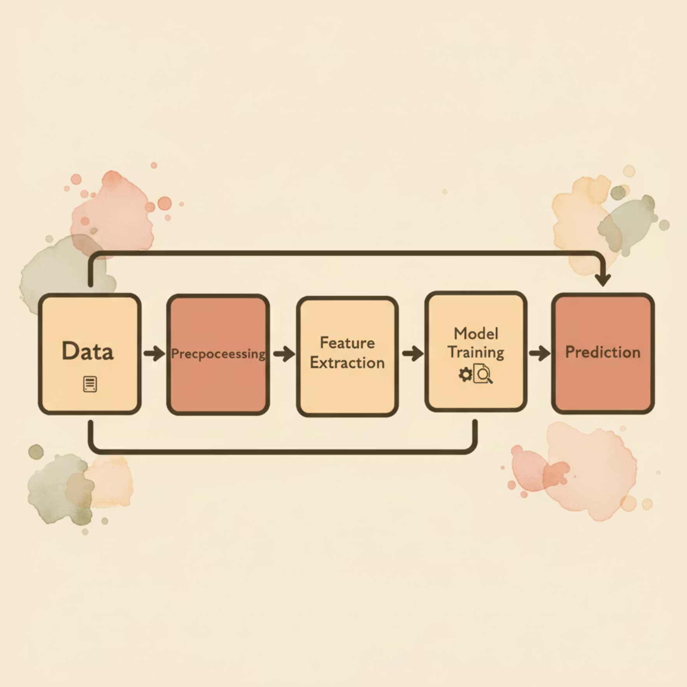

Dataset and Methodology: Building a Robust System
Methodological Approach
Dataset Selection and Preparation
Our development process followed a comprehensive machine learning pipeline:
Our system was trained using a Kaggle Employee Review Dataset, which comprises real employee feedback along with associated ratings. To enable emotion detection, we:
Text Preprocessing: Applied standard techniques such as stopwords removal, tokenization, and lemmatization to clean and standardize the text data.
Mapped numerical ratings to sentiment categories, creating initial emotion labels.
TF-IDF Vectorization: Converted processed text into numerical vectors, representing
the importance of words in documents.
Addressed class imbalance within the dataset using techniques like class weights and oversampling to ensure fair and accurate model training across all emotional categories.
Classifier Training: Utilized robust classification algorithms including Logistic Regression, Support Vector Machines (SVM), and LinearSVC.
Model Evaluation: Assessed performance rigorously using metrics like accuracy, confusion matrices, and detailed classification reports.

Slide 6

Technology Stack: Tools Powering Our Solution
Our AI-driven feedback analysis system is built on a foundation of cutting-edge and widely-adopted technologies, ensuring scalability, performance, and ease of use.
Programming Language
Python: The core language for development, renowned for its extensive libraries in ML and NLP.
ML & NLP Libraries
scikit-learn: For machine learning algorithms; NLTK: For natural language processing tasks; TF-IDF & CountVectorizer: For text feature extraction.
Dataset Source
Kaggle: Providing real-world employee review data for robust model training.
Backend Framework
Flask / FastAPI: Lightweight web frameworks for building efficient API endpoints and serving the model.
Frontend Development
HTML, CSS, JavaScript: Standard web technologies for creating an intuitive and responsive user interface.
Development & Deployment
VS Code Local Environment: For streamlined development and testing before deployment.

Slide 7
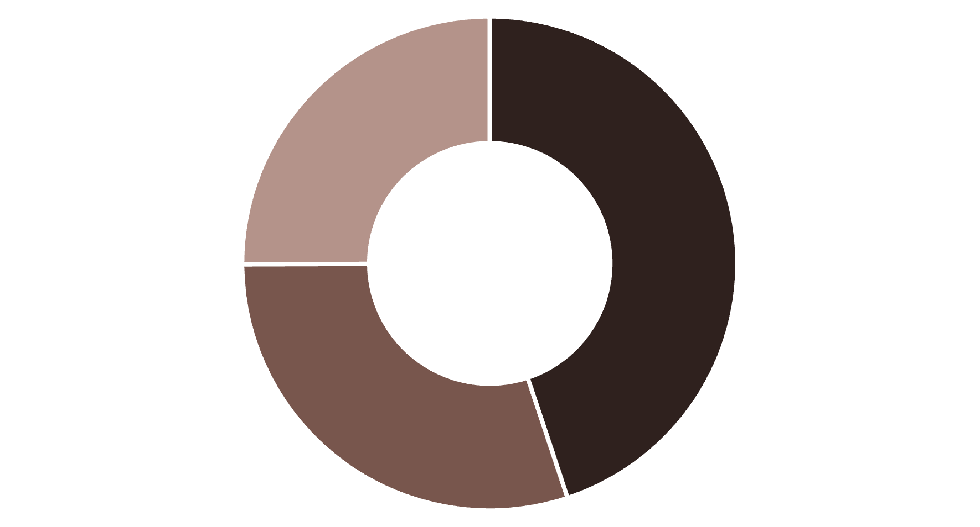


Key Results and Transformative Findings
Visualizing Performance
Impactful Outcomes
Successfully classified employee feedback into multiple distinct emotional categories, providing granularity beyond simple positive/negative sentiment.
Achieved significant improvement in model accuracy and reliability after meticulously handling dataset imbalance, ensuring unbiased insights.
Developed a user-friendly web interface that delivers real-time feedback analysis, making immediate insights accessible to HR teams.
Equips HR professionals to swiftly identify patterns in workplace satisfaction, pinpoint emerging concerns, and address them proactively.
Positive
Neutral
Negative
The chart illustrates a typical distribution of sentiment detected across employee feedback, demonstrating the system's capability to categorize emotions effectively. Our confusion matrix (not shown) further validates the model's precision and recall across all emotional classes.

Slide 8
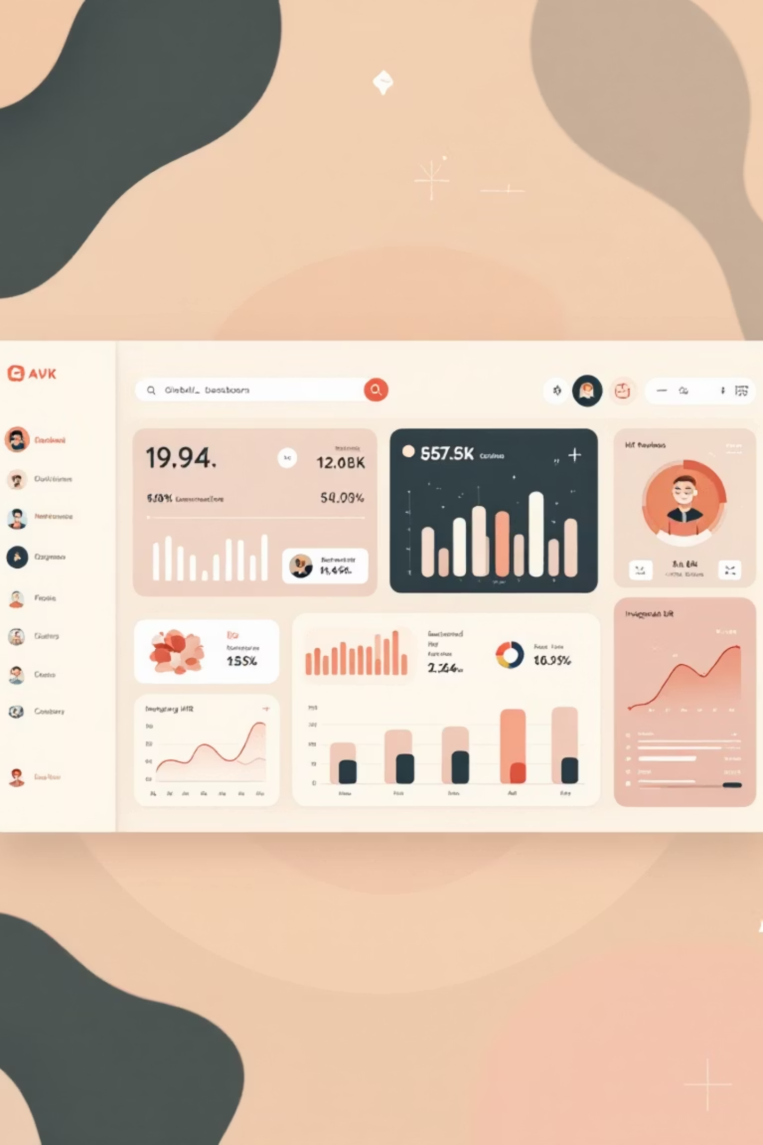


Conclusion and Future Vision
Project Conclusion
Our AI-driven system stands as a robust solution for accurately analyzing employee feedback, translating raw text into actionable emotional insights. It significantly reduces manual HR workload, fosters a deeper understanding of employee well-being, and empowers data-informed decision-making.
Future Scope & Enhancements
Enterprise Dashboard: Develop and deploy a comprehensive, interactive dashboard for C-suite and HR leadership.
Multi-Language Support: Extend emotion detection capabilities to support diverse global workforces.
Advanced Deep Learning: Integrate state-of-the-art models like BERT and LSTM for even greater accuracy and contextual understanding.
HRMS Integration: Seamlessly connect with existing HR Management Systems for continuous, automated monitoring.

